Slide 1

A Data Story about a bike that goes nowhere
Rebecca V. Lewis
Bellevue University DSC 680 – Project 3 June 3, 2021
https://github.com/RebeccaLewis-DS/dsc680-project3
Notes:
A Data Story about a Bike that Goes Nowhere
By Rebecca Lewis for Bellevue University’s Data Science 680 course
Presented on June 3, 2021
Accompanying paper, data, and code can be found in my github account at github.com slash RebeccaLewis hyphen DS slash dsc680 hyphen project3

Slide 2

Evolution of Home Workouts
Methods:
VHS Tapes
DVDs
Streaming
Equipment:
Weights
Treadmills
Gimmicks
Notes:
In 2021, at home workouts are the norm, thanks to the pandemic shutting down gyms around the country.
The earliest form of at home workouts began with VHS tapes in 1979 and exploded with Jane Fonda’s workout series in the 1980’s. [3] As technology evolved, the workout video format moved to DVDs, then streaming from computers and tablets. [3]
The home fitness equipment industry was booming in the 1990s with sales of traditional workout equipment like weights and treadmills as well as novelty items like the Thighmaster and Shake Weight. [5]

Slide 3



Home Workouts in 2021
Notes:
In recent times, we have seen a combination of digital fitness and equipment where a customer can get the instructor led coaching, on gym quality equipment in the comfort of their home. Peloton® was founded in 2012 with a mission to “use technology and design to connect the world through fitness, empowering people to be the best version of themselves anywhere, anytime.” [7]
By 2019, they sold over 400,000 indoor spinning bikes and had introduced their treadmill in 2018. [4] From January to March of 2020, sales of fitness equipment shot up 55% during lockdown. [5]

Slide 4


What’s the Problem?
Motivation
Notes:
Well, great! With all this accessibility, there should be no problem with getting in a workout, right? Wrong. You need motivation.
Even though having the equipment at home can reduce the amount of time needed to fit a workout into a routine, a 2016 study found that motivation to exercise comes from incentives and rewards to sustain the habit long enough for health to be a motivator. [8] I purchased the Peloton Bike in 2017 and it was used as an expensive coat rack until I found my motivator…

Slide 5




Sources of Motivation
Health
MOney
Games
Data
Notes:
Ideally, we should all be motivated to exercise by better health. However, achieving health through diet and exercise takes time and people may need more of instant gratification to keep up momentum.
Friends, colleagues and even strangers begin competitions that reward the person who achieves the best results with money. Many of these programs require an up front fee, and that is not always possible for people who need to get fit.
An article published in Smart Health 2016 about the impact of wearable trackers, found that the gameification of weight loss and health goals was a motivating factor to continue good habits. Participants competed in fitness challenges and were awarded badges for completing them.
If none of these options work, there is always data. In 1985, the effect of percentile-based feedback on intrinsic motivation was evaluated on seventh and eighth grade children and the study found that children. The intrinsic motivators of enjoyment, competence, effort were improved for children who were given percentile rankings of 80% and above.
I learned my motivation came from data and metrics from Peloton’s Power Zone training program, we’ll talk more about that later.

Slide 6

Objective
This project examined the Peloton® workout history for an individual user to determine the factors that influence their performance, correlation between workouts and weight, and improvement in overall fitness over time.
Notes:
Which brings us to the objective of this project. exploring the data generated from one participants Peloton® workout history to determine the factors that influence their performance, correlation between workouts and weight, and improvement in overall fitness over time. The results can be used to motivate the participant as well as direct their efforts to the most effective workouts to achieve their goals.

Slide 7
The Process
Data Wrangling and Preparation
Data Analysis and Visualizations
Modeling and Performance Evaluation
Notes:
Workout data was retrieved from Peloton’s API and weight data was extracted from the participant’s apple health kit. The data was explored to determine the most interesting variables and organized into a format to be plotted and analyzed.
The most interesting variables were analyzed using statistics and visualizations and were explored for dependent relationships.
Finally, a model was created to predict the difficulty estimate of a workout based on the participant’s cycling metrics related to their performance.

Slide 8

Data
Workouts
Summary
Performance
Instructors
Weight
Notes:
The data was mined from four different files downloaded from the Peloton API and one file from the Apple Health Kit.
The workouts file contains general information about each workout performed by the user such as date and time, type of workout, and other descriptors.
The workouts summary file contained the same data in the workouts file along with metrics about the ride in general, such as the difficulty rating and duration.
The workout performance file contained metrics about the workout specific to the user such as output, heart rate, cadence, resistance and more.
The instructor’s file was downloaded to retrieve the name of the instructor for each workout for visualization purposes.
The participant uses a Bluetooth scale which syncs data to the Apple’s Health App. The xml file downloaded from Apple Health was filtered to only include body mass and lean body mass from the scale app.

Slide 9


Data Preparation
Irrelevant and redundant variables were removed
Data from separate files were combined
Date/time values were converted from epoch time
Missing values for average heart rates were imputed
Multiple body mass values recorded on the same day were averaged.
Weights were combined to workouts based on date
Notes:
Each workout file was individually parsed, and relevant metrics were extracted, while irrelevant and redundant variables were removed
Once this process was complete, the respective data files were joined together by the unique workout id.
All date/time values were in epoch time format, represented as a ten-digit number and were converted to central time. However, during exploratory data analysis some unusual time ranges were noted where the participant does not usually workout. So in the end they were removed.
Cycling workouts that were completed without a heart rate monitor contained a 0 for the heart rate metrics. Mean values were imputed from the average values for other workouts with the same duration of activity.
Fourteen dates were found to have multiple body mass measurements with different values. Rather than removing the duplicate observations, the mean of the weight values was calculated for each day. The weight data was merged with the main dataset based on date.

Slide 10

Analysis
Notes:
Once the data preparation was complete, univariate and multivariate analysis was performed with visualizations to further investigate the data. The target variable for the modeling phase of this project was chosen based on this analysis.

Slide 11
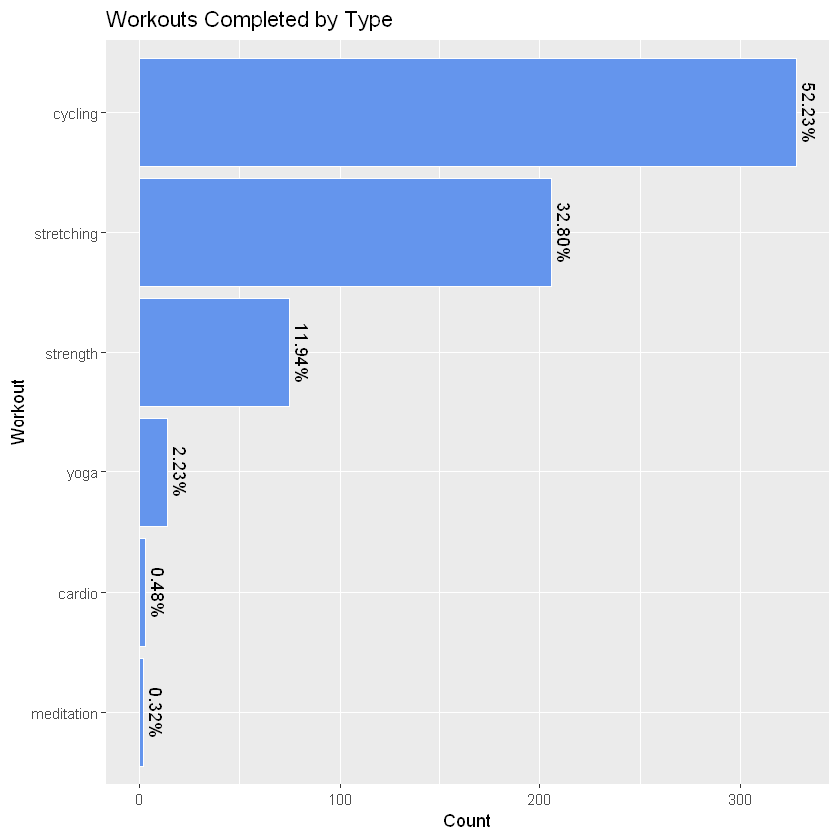



All Workouts 2017-2021
52%
32%
12%
Notes:
Cycling workouts represented approximately 52% of the total workouts performed between 2017 and 2021, followed by stretching workouts at ~32% which makes sense as the participant stretches after many workouts. Almost 12% of the workouts completed were strength workouts.
The number of workouts for cardio, meditation, and yoga are too low to get an accurate representation of their overall difficulty, duration or calories burned and were not used in further analysis.

Slide 12
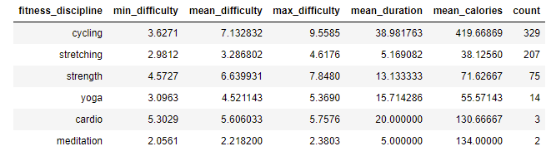
All Workouts 2017-2021
3.6-9.5
2.9-4.6
4.5-7.8
Notes:
The difficulty of cycling workouts ranges from 3.6 to 9.5 with a mean of 7.1. As expected, stretching workouts have a lower min, mean, and max difficulty with a range from 2.9-4.6 and a mean of 3.2. Strength workouts were the most consistent in difficulty with the smallest range between the min of 4.5 and max of 7.8 and a mean difficulty of 6.6.
The duration for cycling workouts were typically larger with a mean of 38.98 minutes. When viewing the duration of workouts by type, cycling was the only type of workout with a length of 45, 60 and 90 minutes. The mean calories burned for cycling was also the largest with 419.67 kcal. Again, the additional length of these types of workouts likely contributed to the higher caloric burn.
Because cycling workouts represented most of the dataset and had the most available metrics, further analysis was performed on cycling workouts only.

Slide 13
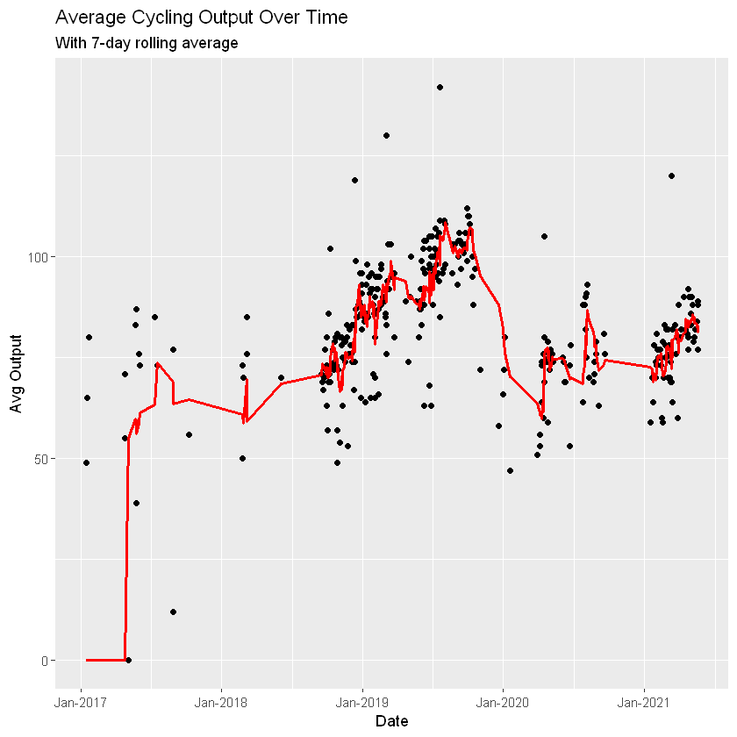
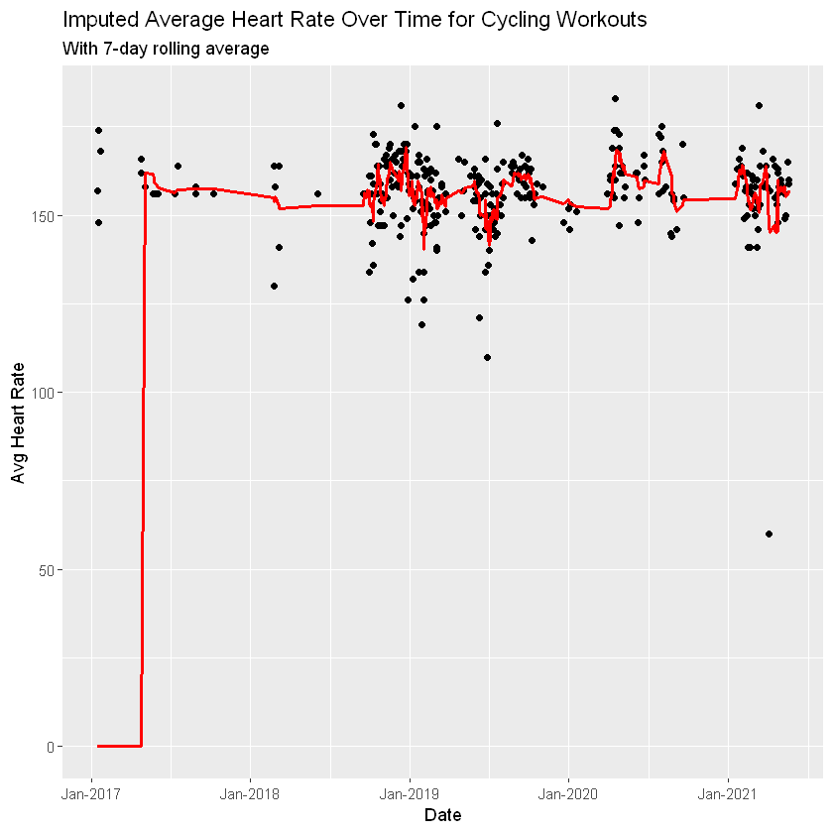
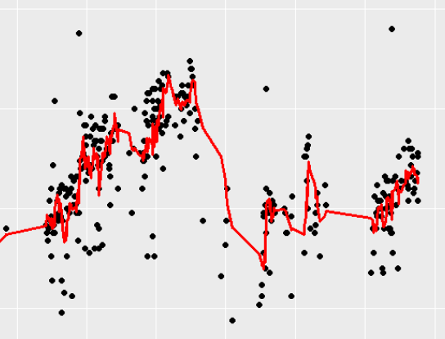
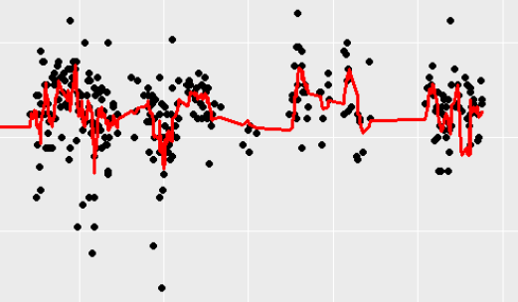
Cycling Workouts
Notes:
The most informative metrics within cycling workouts were the average output and average heart rate. Three periods of consistent cycling activity were evident when average output was plotted from 2017 through 2021. Gradually increasing average output was observed within each cluster. The longest time period of consistent activity was from end of year 2018 through the end of 2019. A gap in activity and a drop in average output was observed between 2019 and 2020. This coincided with a period of time in which the participant had multiple surgeries for treatment of a health issue. Even though the average output was lower when resuming cycling activity, the average output continued to increase as long as the workouts were consistent. The participant had another surgery in late 2020 but the average output stayed consistent when activity resumed.
Initially, it seems that the average heart rate remains constant through the periods of activity. However, when we zoom in, we can see the average heart rate gradually reduces with consistent activity. After the lapse of activity due to surgeries, heart rate was consistency higher than before which makes. With the most recent cluster of consistent exercise, the average heart rate is observed to be gradually decreasing again.

Slide 14
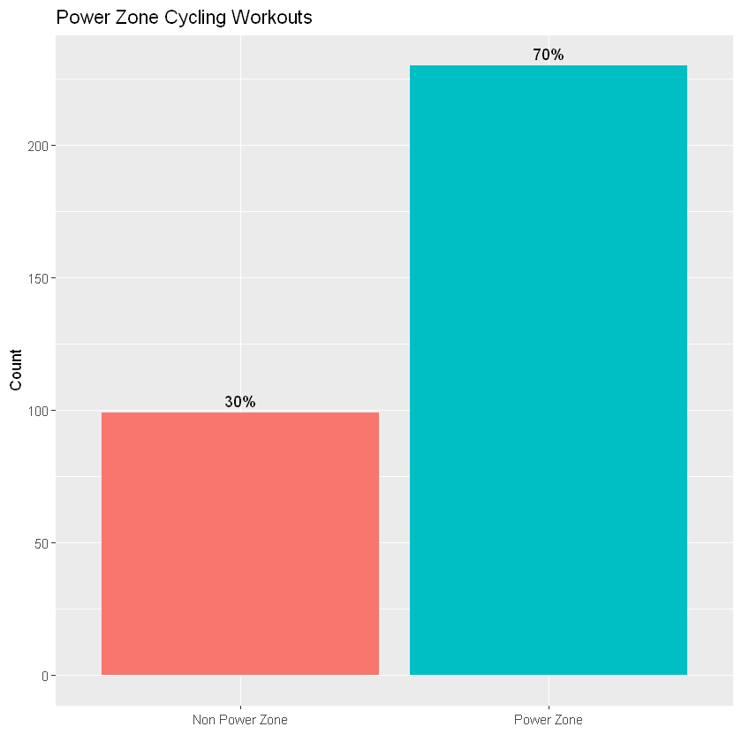
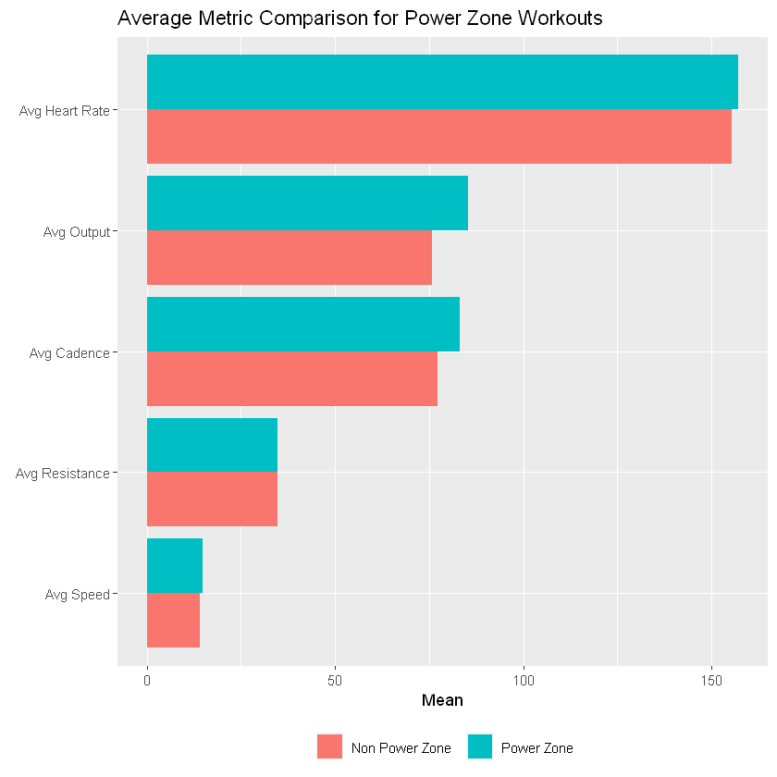
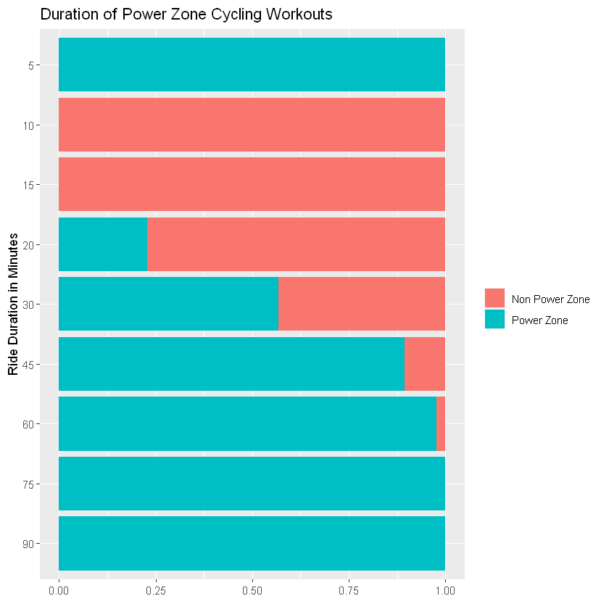
Power Zone Workouts
Notes:
Power Zone training is a method in cycling that focuses on 7 zones of power intentionally combined during workouts to achieve specific fitness results. [6] The output metric is the cue to indicate the desired effort to exert. [6] Participants take a functional threshold power test when starting to train, which is the base for their 7 zones. Once those zones feel easy, they can retest to get new and improved zones.
Seventy percent of cycling workouts completed by the participant were Power Zone rides.
The average metrics for cycling workouts were compared for Power Zone and non-Power Zone (regular) rides. The Power Zone rides had higher averages for output, cadence, heart rate and speed. The average resistance for both types of rides was almost the same.
The higher metrics for power zone rides could be related to the fact that the duration of power zone rides is typically longer than the regular rides. To avoid bias in modeling, the power zone binary indicator was removed from the set of features.

Slide 15
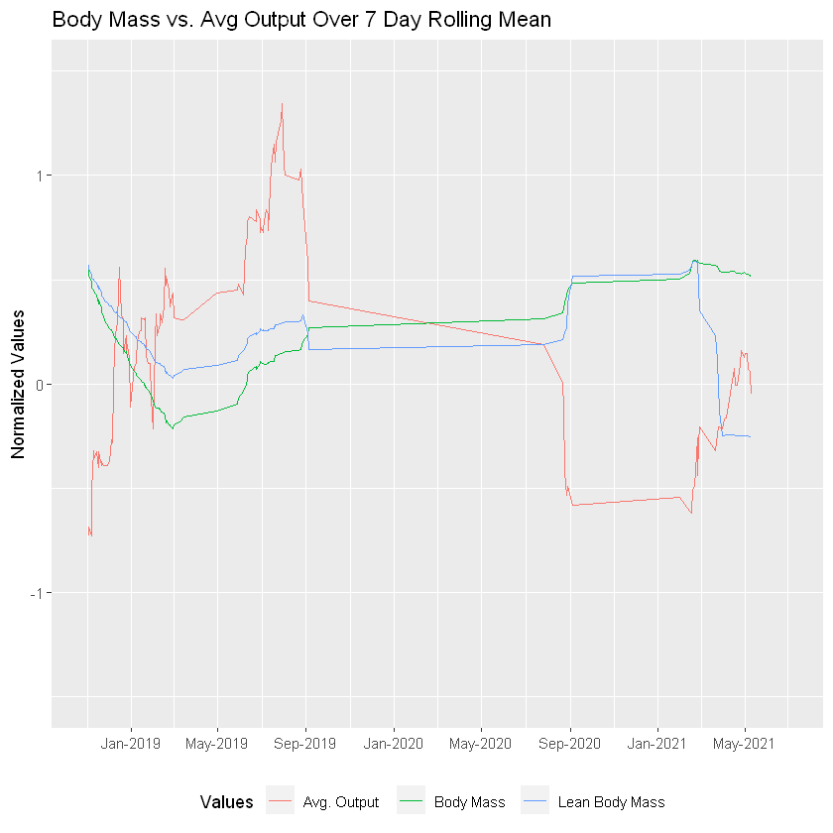
Body Mass vs Output
Lean Body Mass
Output
Body Mass
2018 – Apr ‘19
Jun ‘19 – Sep ‘19
Sep ‘19 – Jan ‘21
Jan ‘21– May ‘21
Notes:
To explore the effect of cycling workout intensity on weight, the body mass and lean body mass were plotted over time with the average output. Three interesting trends were observed. From early 2018 through April of 2019, the body mass (both lean and overall) plummeted as the output increased; however, during another period of increased output in mid-2019, the body masses increased.
One possible explanation could be that because the average output saw a large jump, the participant was likely to have retaken the power zone test and had more difficult zones. Because of this, resistance increased which would build muscle, increasing weight.. Another explanation could be changes in diet between early 2019 and late 2019.
During periods of low activity, the lean body mass dropped, and the overall body mass rose. As the participant began to workout consistently again, the both body mass measures began to drop again.
A concerning note is that the lean body mass plummeted disproportionately around February 2021. Around this time the participant reset the body type mode from athletic mode to regular mode, which calculates the lean body mass as a lower percentage of total weight. Because of this and the low correlation of lean body mass to the other variables, it was excluded from modeling.

Slide 16
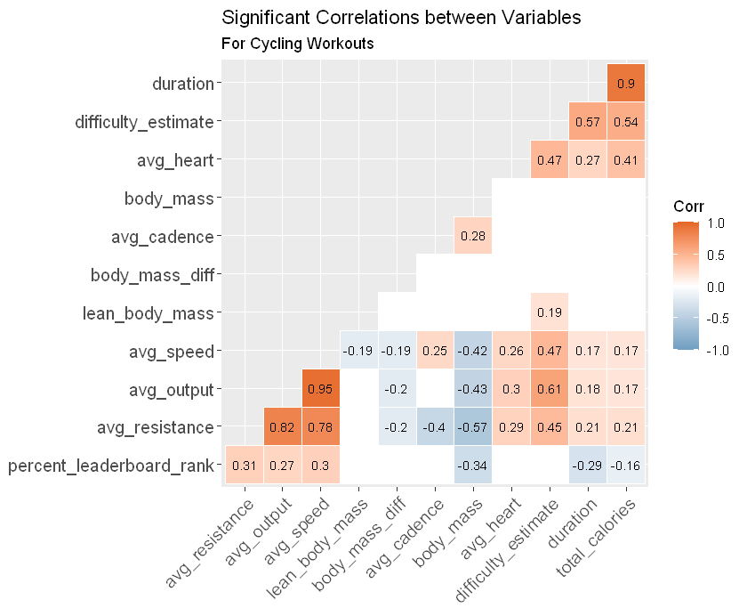
Interesting relationships
Body Mass
Average Speed, Average Output, and Average Resistance
Average Cadence
Difficulty Estimate
Notes:
Relationships among the variables are shown in this correlation plot. A few of the most interesting relationships include:
Body Mass - The body mass variable is the weight of the participant on the day of the ride. Body mass has a moderately negative relationship with leaderboard rank, average resistance, average output, and average speed. Body mass is also slightly positively correlated with average cadence indicating at higher weights, the participant rides at higher cadences. When the participant’s mass is higher, their performance suffers, and they tend to ride at higher cadence which requires more cardiovascular energy and less muscle energy. Lean Body Mass and the change in weight over 1 day did not have any significant relationships to the rest of the data.
Positive relationships between average speed, average resistance, and average output were expected; however, the magnitude of those relationships was not. Surprisingly, the relationship between average output and average cadence was not significant indicating cadence does not have an impact on raising ride output.
Initially, cadence was thought to have a higher impact on the perceived speed on a ride since cadence is measuring the rotations per minute. Based on the correlation values, average cadence influences speed only slightly. Average speed is primarily affected by the average resistance
Statistically significant strong positive relationships for difficulty estimate include duration, average output, average resistance, average speed, total calories, and average heart rate. Based on this information, difficulty estimate was determined to be the best target variable for the modeling component of this project.

Slide 17

Rating the DifficultY
Features
duration
avg_output
avg_cadence
avg_resistance
avg_speed
total_calories
avg_heart
percent_leaderboard_rank
Notes:
The features used to predict the difficulty rating for a cycling workout include.

Slide 18
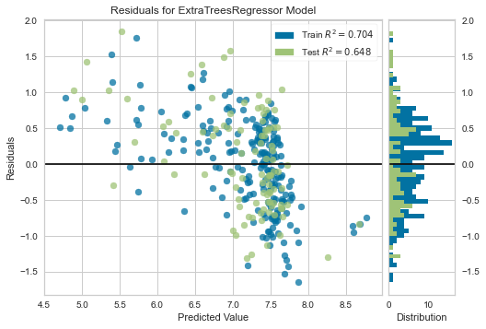
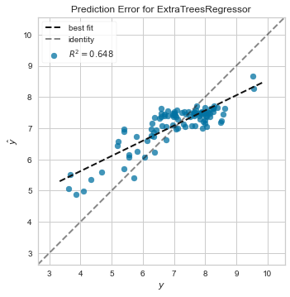
Rating the Difficulty – Model 1
Notes:
The initial model was based on the best performing algorithm, Extra Trees Regressor. The extra trees regressor algorithm fits randomized decision trees on different samples of the data and averages them to improve accuracy and reduce the risk of overfitting. After the model was tuned, the residuals were plotted and the performance was evaluated. The overall R² value for the training set was .70 and the R² value for the test dataset was .64, which refers to the percentage of variation explained by the model. These are good results; however, the plots of the residuals exhibits heteroscedasticity, meaning the higher difficulty ratings were predicted more accurately than the lower difficulty ratings. This indicates that improvements can be made.

Slide 19
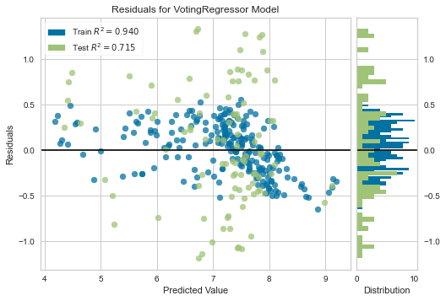
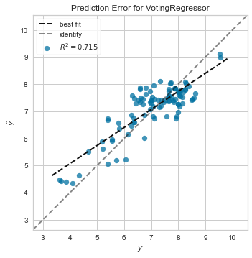
Rating the Difficulty – Model 2
Notes:
The multicollinearity threshold parameter was lowered from .9 to .75 because so many strong correlations were observed between the variables. The top performing models were the K Neighbors Regressor and the Extra Trees Regressor. The K Neighbors regressor algorithm predicts numerical values by a similarity score among the closest data. These algorithms were blended to a Voting Regressor model which was trained on the data. . The performance improved as noted in the training dataset R² score increasing to .94. The test dataset R2 increased to .71, meaning the model accounted for 71% of the variation in the test data. When looking at the prediction error plot, the line of best fit is closer to the identity line.

Slide 20

Conclusion
Notes:
Based on this participant’s metrics, cycling workouts offer the most variety in difficulty while strength workouts are the most consistent with moderate difficulty. When activity stops for long periods of time, weight loss stalls or increases, resistance decreases, and cadence is not affected. The participant’s body mass at the time of the workout was a factor in the amount of energy they could expend during a ride. At a higher body mass, the participant tends to rely on cadence to complete rides rather than resistance. Higher cadence efforts depend on the cardiovascular system more so than the muscular system. [2] In order to build strength, the participant should lower the cadence and increase resistance, leading to increased performance and strength. Surprisingly, resistance played a large factor in increasing the speed and output during a cycling workout while cadence had little to no effect. Speed, output, and resistance cause the heart rate to rise more so than cadence which leads to more calories burned. The participant enjoys endurance rides that typically have a longer duration and a higher caloric burn. These variables are negatively associated with the percentile rank on the leaderboard. If the leaderboard is a motivating factor for cycling workouts, then the participant should consider varying their activity with shorter and higher intensity rides.
Overall, this project aimed to connect metrics measured during a specific Peloton® user’s workout history and their weight loss. Consistency in general is key in both improving athletic performance and affecting weight loss more so than specific metrics within the workout. I plan to continue working on this model as more workout data is gathered.

Slide 21

Thank you
Rebecca V. Lewis Peloton: #RevIt_Becca
Email: revlewis79@gmail.com Portfolio: RebeccaLewis-DS.github.io LinkedIn: https://www.linkedin.com/in/rebeccavlewis/
Notes:
Thank you for listening to me talk about one of my favorite things. Feel free to reach out with any questions. See you on the leaderboard!

